Slide 1
Project Proposal

Slide 2
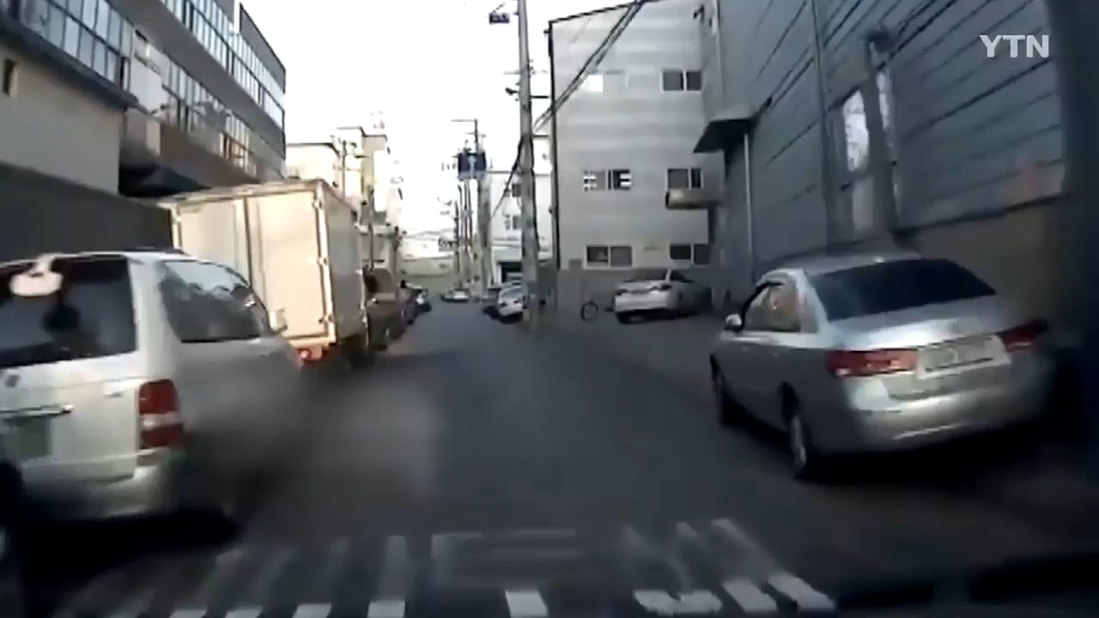
Target Users

Slide 3
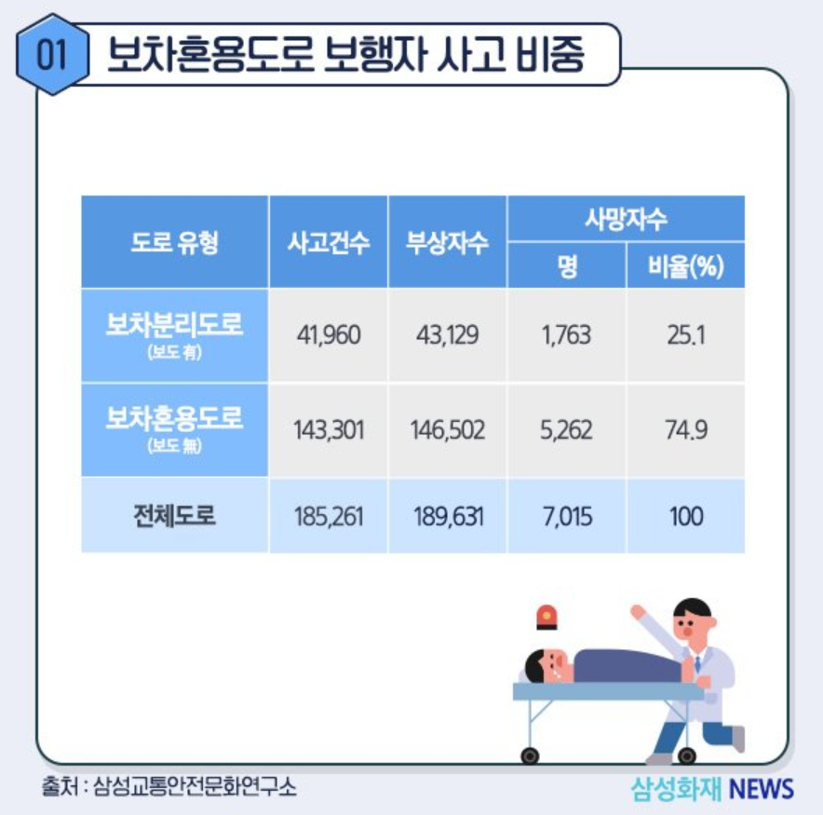
Target Users

Slide 4
Target Users
Problem : Accident due to unexpected vehicles’ behavior
Target Users : Pedestrians

Slide 5
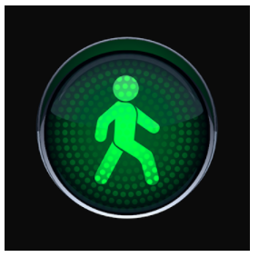
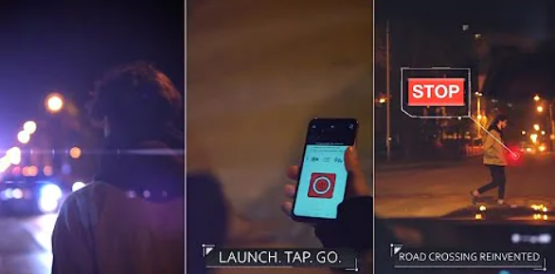
Existing solutions and their limitation
Main Role : Provide safer pedestrians’ life by
showing bright flash to drivers
Crosswalk Assistant

Slide 6
Existing solutions and their limitation
Main Role : Provide safer pedestrians’ life by
showing bright flash to drivers
Limitation :
Only helpful for passing crosswalk
Hard to predict vehicle’s behavior
Crosswalk Assistant

Slide 7

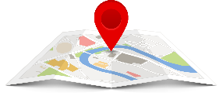
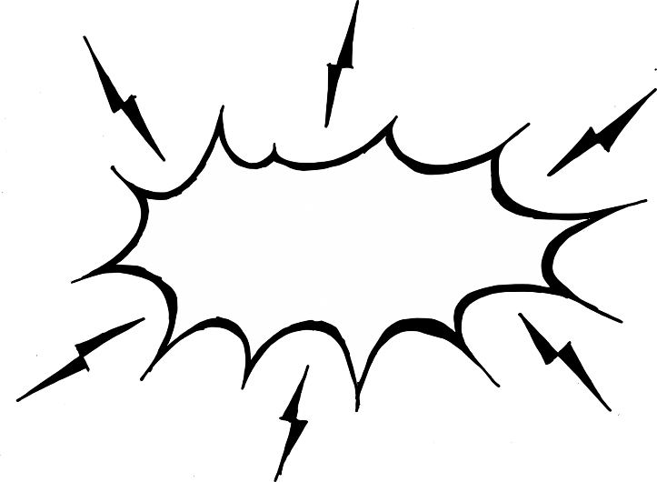

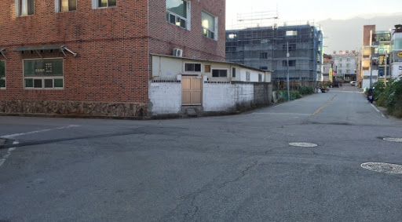
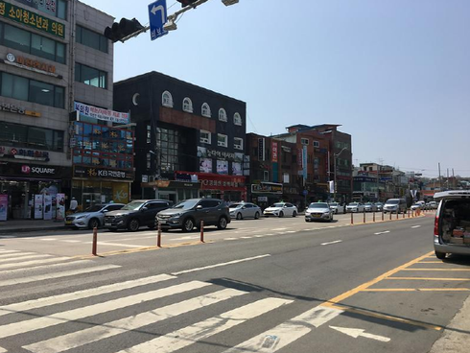
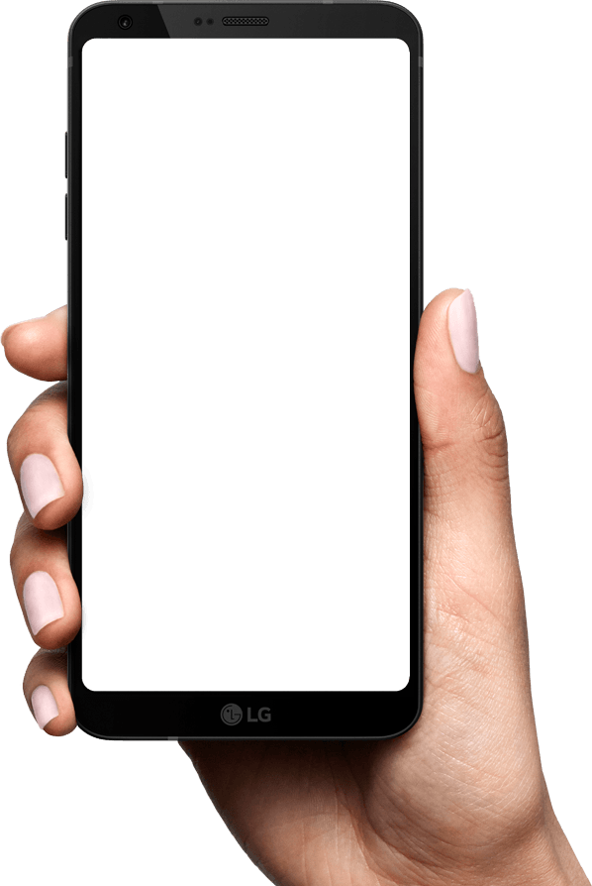
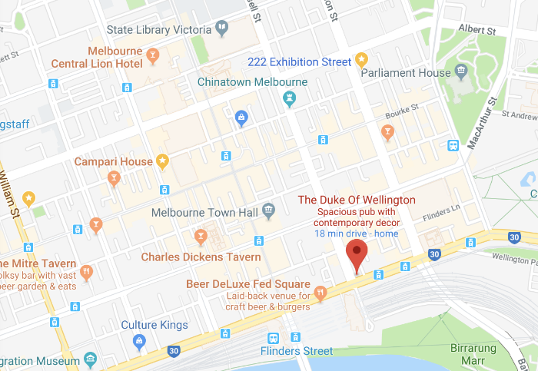
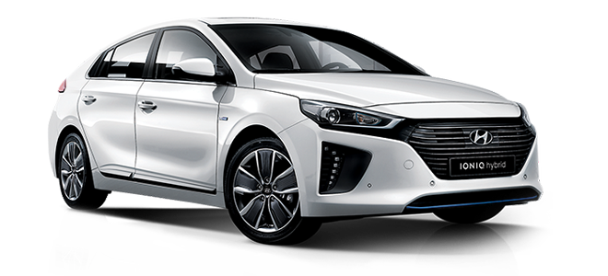

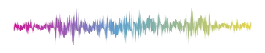
Key Idea
Enhancing Traffic Situation Awareness by Sensors(Bluetooth, GPS, etc.,)
We alert pedestrians of dangerous situation by using
Warning!
Car is approaching
Warning!
Intersection ahead
Beacon

Slide 8
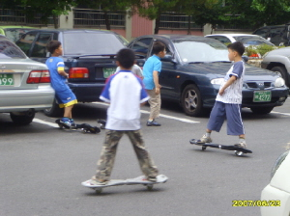
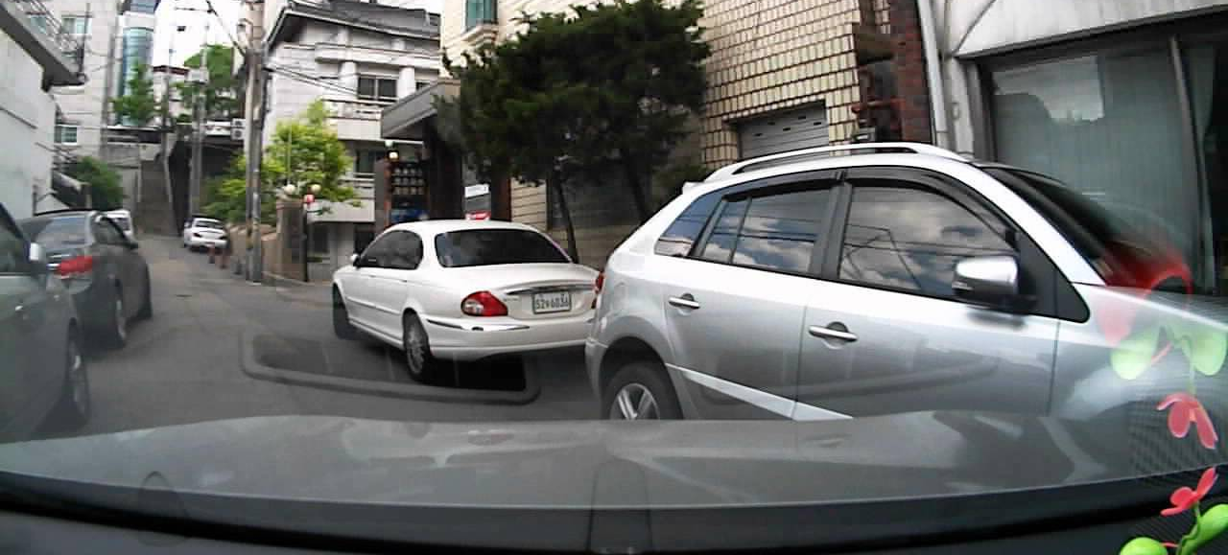


Usage Scenarios #1 - Parking Lot
Children are in a parking lot
A vehicle with a beacon on it approaches
Children hear an alert from the application
Warning
The children check to see if the car is coming.

Slide 9
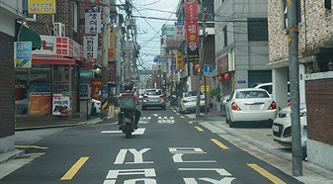
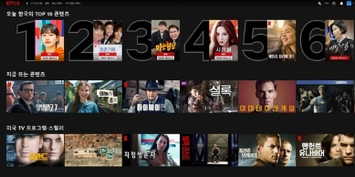
Usage Scenarios #2 - Intersection
A man walks towards the intersection
The man is watching a video
A location-based alert is generated
Warning
Pedestrian checks to see if the car is coming.

Slide 10


System Overview
Beacon
Server
Mobile
GPS
Database
Beacon Handler
Signal
Transmission
GPS Localization
Alert

Slide 11
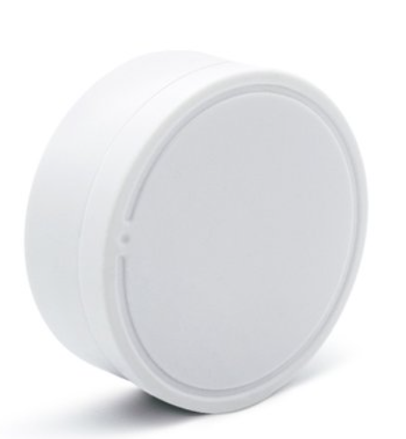
Expected Challenges
Limitation :
- Lack of accuracy
- Signal interference
Beacon
Overcome :
- Solid Algorithm based on existing research

Slide 12
Evaluation strategy
Measure the device alerts at the proper time and distance
check if the alert is sent or not in a proper time
measure the latency from when data is received to when alert is sent
Experiment is conducted in several use cases with varying parameters
speed of the vehicle
speed of the pedestrian (mobile device)
distance between the vehicle and the pedestrian (mobile device)
Count the number of occasions of correct alert and analyze the result
distance and speed range to provide guaranteed notification

Slide 13
Overall project plan
K : Kim, Do Hyung
P : Park, Seonghyeon
C : Choi, Jin
Milestone | Item | 3 |  | 4 |  |  |  | 5 |  |  |  |  | 6
 |  | 4 | 5 | 1 | 2 | 3 | 4 | 1 | 2 | 3 | 4 | 5 | 1
Proposal | Prepare presentation | K, P, C
Review/Demo (May 3) | Design the overall architecture |  | K, P, C
 | Build application |  |  | K, P | K, P | K, P
 | Build server |  |  | C | C | C
 | Prepare demonstration |  |  |  |  |  | K, P, C
Final presentation (June 7) | Test and improve the functionalities of the application |  |  |  |  |  |  | K, P | K, P
 | Test and improve the functionalities of the server |  |  |  |  |  |  | C | C
 | Experiment and analyze the result |  |  |  |  |  |  |  |  | K, P, C | K, P, C | K, P, C
 | Prepare demonstration |  |  |  |  |  |  |  |  |  |  | K, P, C | K, P, C
 | Prepare final presentation |  |  |  |  |  |  |  |  |  |  |  | K, P, C

Slide 14
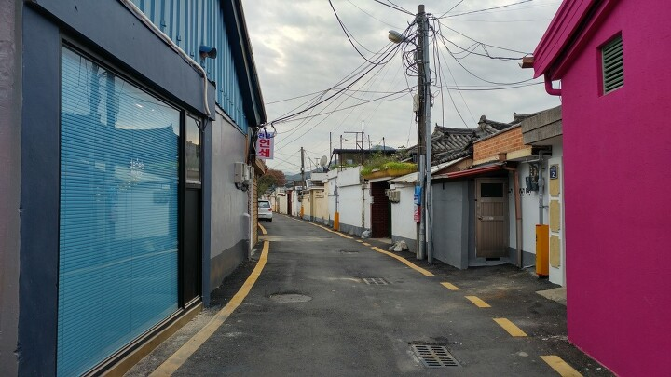

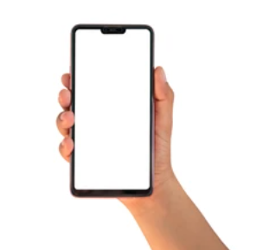

Final deliverable
Android based mobile application that recognizes nearby moving vehicles and alerts the user when they are close enough.
Success Criteria
The effective of the application will be shown based on the experiment.
알림: 움직이는 차가
10m 거리에 있습니다.

